Slide 1
Veggies Bistro Restaurant

Slide 2
Attributes | Value
Font Color | #a3a375 / #000000
Page Header Color | #ff3333 / #258e25
Page Color | #b8ff4d
Text Background Color | #a3a375
General Font | Oxygen
Business Name Font | Baskerville Old Face
Page Footer Color | #a3a375 / #1f7a1f / #155115
Logo Color | #ff3333

Slide 3
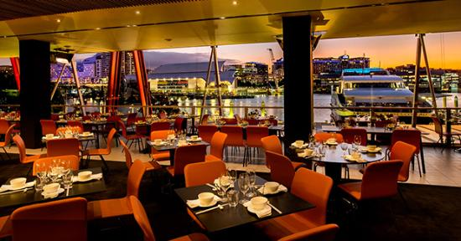
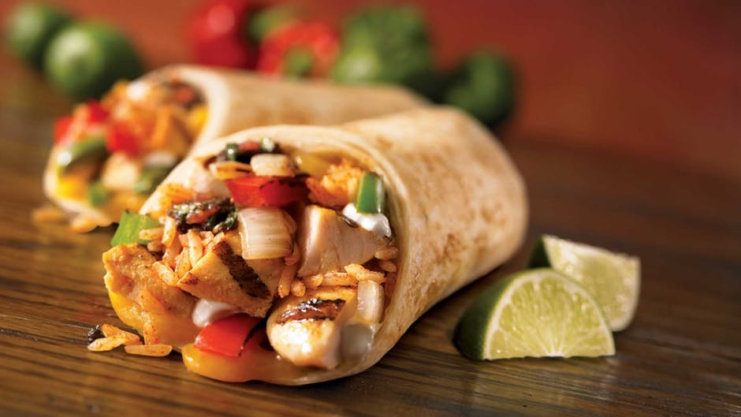
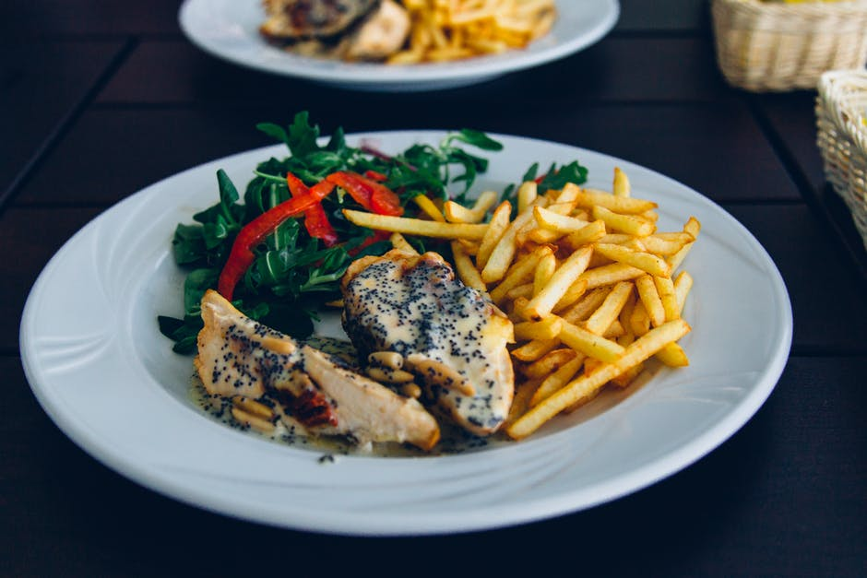
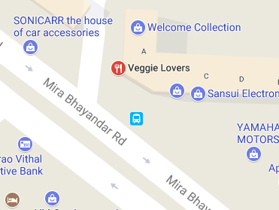
*Vegetarian Only
*Home Delivery Available
Veggies Bistro
022-28123676
Home
Menu
Gallery
Offers
Home Page – Desktop/Tablet
MENU
SPECIALS
MAP
Operating Hours:
Mon-Fri : 9 a.m. – 12 Midnight
Sat : 11:30 a.m. – 12 Midnight
Sunday Closed
“House of South Indian food a place where you like to have dosa or idlie. Good family restaurant and attentive staff. ”
“House of South Indian food a place where you like to have dosa or idlie. Good family restaurant and attentive staff. ”
Address:
209, Mahesh Industrial Estate, Opposite Silver Park, Mira Bhayander Road, Mira Road East, Mira Road, Mumbai

Slide 4
*Vegetarian Only
*Home Delivery Available
Veggies Bistro
022-28123676
Home
Menu
Gallery
Offers
MENU CATEGORIES
SOUTH INDIAN
DOSAS
SANDWICHES
PIZZA
Menu Categories – Desktop/Tablet
PAV BHAJI
STARTERS
VEG GARDEN
NORTH INDIAN
DESSERT
BEVERAGES

Slide 5
*Vegetarian Only
*Home Delivery Available
Veggies Bistro
022-28123676
Home
Menu
Gallery
Offers
MENU LIST
-Description
-Price
-Description
-Price
A1
A4
Menu List– Desktop/Tablet
-Description
-Price
-Description
-Price
A2
A5
-Description
-Price
-Description
-Price
A3
A6

Slide 6



